Slide 1
Haplotype Assembly
By Patrick Tan

Slide 2
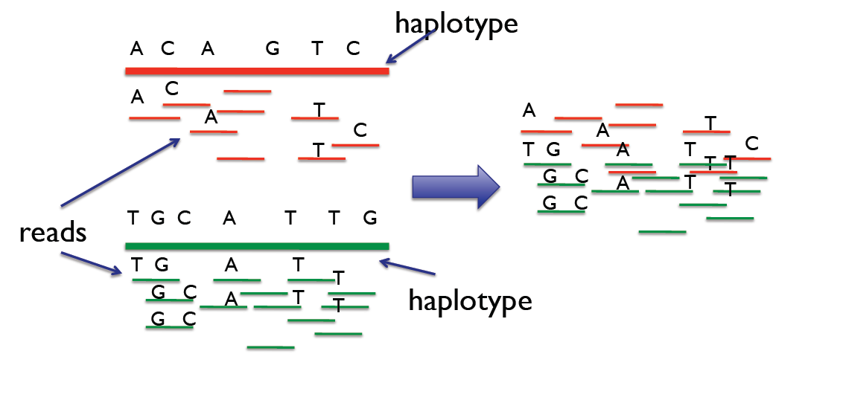
Background and Motivation
We want to read the haplotypes from a part of the genome
Haplotypes can be used for association studies, investigating diseases
We take multiple reads of parts of the haplotype
Only read short parts at a time (cheaper)

Slide 3
Example Read
Only need to keep heterozygous SNPs
We can represent these SNPs as binary strings of 0s and 1s
ATCGATGGCA
ATGGAACGGA
--C--TG-C-
--G--AC-G-
0010
1101

Slide 4
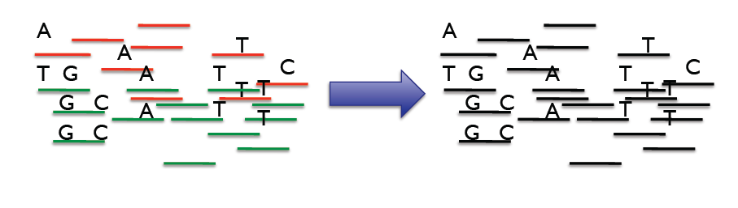
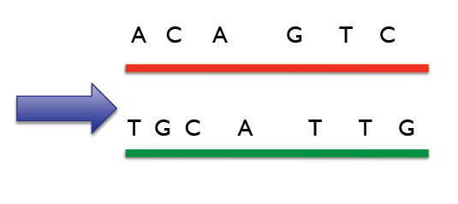
The Problem
However, there are two haplotypes per chromosome and each reads can only be taken on one haplotype
We don’t know which reads correspond to which haplotypes
We want to tile the reads together to recreate the two haplotypes

Slide 5
Computational Problem
Input: Given n reads for m SNPs (n x m matrix), where each row is a read from one of the two haplotypes
Output: Two complementary haplotypes of lengths m SNPs that match the reads given in the input.
Benchmarks
Time: Speed of algorithm
Expect O(n*2^m) for brute force and O(n) for greedy
Accuracy: Errors are counted by the number of switches made between the solution haplotypes and the original haplotypes
Since we have no sequencing errors, errors will be very uncommon

Slide 6
Haplotype Example Read Matrix (Input)
Haplotype1 0 0 1 1 0 1 0 0 1
Haplotype2 1 1 0 1 0 1 0 0 1
reads | 0 | 1 | 2 | 3 | 4 | 5 | 6 | 7 | 8
read1 | 0 | 0 | - | - | - | - | - | - | -
read2 | 1 | 1 | - | - | - | - | - | - | -
read3 | - | 0 | 1 | 1 | - | - | - | - | -
read4 | - | - | 0 | 0 | 1 | - | - | - | -
read5 | - | - | - | 1 | 0 | - | - | - | -
read6 | - | - | - | - | 0 | 1 | 0 | - | -
read7 | - | - | - | - | 1 | 0 | - | - | -
read8 | - | - | - | - | - | 1 | 0 | 0 | -
read9 | - | - | - | - | - | - | 1 | 1 | 0
read10 | - | - | - | - | - | - | - | 0 | 1

Slide 7
Haplotype Example Read Matrix (Input)
Haplotype1 0 0 1 1 0 1 0 0 1
Haplotype2 1 1 0 1 0 1 0 0 1
reads | 0 | 1 | 2 | 3 | 4 | 5 | 6 | 7 | 8
read1 | 0 | 0 | - | - | - | - | - | - | -
read2 | 1 | 1 | - | - | - | - | - | - | -
read3 | - | 0 | 1 | 1 | - | - | - | - | -
read4 | - | - | 0 | 0 | 1 | - | - | - | -
read5 | - | - | - | 1 | 0 | - | - | - | -
read6 | - | - | - | - | 0 | 1 | 0 | - | -
read7 | - | - | - | - | 1 | 0 | - | - | -
read8 | - | - | - | - | - | 1 | 0 | 0 | -
read9 | - | - | - | - | - | - | 1 | 1 | 0
read10 | - | - | - | - | - | - | - | 0 | 1

Slide 8
Creating the Read Matrix (Simulation)
We first generate a haplotype with simulated random distances between each SNP
We set a probability that each SNP will be heterozygous, and run geometric distributions for the number of homogenous SNPs until the heterozygous SNP.
For each heterozygous SNP, we then randomly assign 0 or 1.
Then, we create the complement haplotype by switching 0s and 1s (keep the same location distances)
45 0 50 0 55 1 49 0
45 1 50 1 55 0 49 1
45 95 150 199

Slide 9
Reads are taken by choosing random locations in the SNP and reading SNPs within a given read length.
These reads are stored into the read matrix (read matrix does not need to store location anymore, just needs to store what number SNP it is)
45 0 50 0 55 1 49 0
45 1 50 1 55 0 49 1
45 95 150 199
For example, a read from 60 to 160 would return either:
-01-
-10-

Slide 10
Baseline Solution: Brute Force (Exhaustive)
Try every possible combination of 0s and 1s of length n SNPs
We do not take into account sequencing errors, so it is almost always possible to get 0 errors
Therefore, just stop once a combination is found that satisfies all reads.
Given that: n is the number of reads and m is the number of SNPs
There are 2^m possible combinations
Each combination can be tested against up to all n reads
Time Complexity is therefore O(n*2^m)

Slide 11
My Solution: Greedy
Loop from first SNP read to last SNP read (must sort the SNPs in order)
First read can be assigned to either haplotype
From there, if the read overlaps with known haplotype, assign each read to its corresponding haplotype (match overlaps)
If unknown (no overlaps), guess
This is the only cause of error since we do not have read errors
Generally, this only occurs when a distance between reads is longer than the read length
Note: it can also occur if we simply do not take enough reads

Slide 12
Example Run
Haplotype1 ? ? ? ? ? ? ?
Haplotype2 ? ? ? ? ? ? ?
reads | 0 | 1 | 2 | 3 | 4 | 5 | 6
read1 | 0 | 0 | - | - | - | - | -
read2 | - | 0 | 1 | 1 | - | - | -
read3 | - | - | 0 | 0 | 1 | - | -
read4 | - | - | - | - | 0 | 1 | 0

Slide 13
read1
Haplotype1 0 0 ? ? ? ? ?
Haplotype2 1 1 ? ? ? ? ?
reads | 0 | 1 | 2 | 3 | 4 | 5 | 6
read1 | 0 | 0 | - | - | - | - | -
read2 | - | 0 | 1 | 1 | - | - | -
read3 | - | - | 0 | 0 | 1 | - | -
read4 | - | - | - | - | 0 | 1 | 0

Slide 14
read2
Haplotype1 0 0 1 1 ? ? ?
Haplotype2 1 1 0 0 ? ? ?
reads | 0 | 1 | 2 | 3 | 4 | 5 | 6
read1 | 0 | 0 | - | - | - | - | -
read2 | - | 0 | 1 | 1 | - | - | -
read3 | - | - | 0 | 0 | 1 | - | -
read4 | - | - | - | - | 0 | 1 | 0

Slide 15
read3
Haplotype1 0 0 1 1 0 ? ?
Haplotype2 1 1 0 0 1 ? ?
reads | 0 | 1 | 2 | 3 | 4 | 5 | 6
read1 | 0 | 0 | - | - | - | - | -
read2 | - | 0 | 1 | 1 | - | - | -
read3 | - | - | 0 | 0 | 1 | - | -
read4 | - | - | - | - | 0 | 1 | 0

Slide 16
read4
Haplotype1 0 0 1 1 0 1 0
Haplotype2 1 1 0 0 1 0 1
reads | 0 | 1 | 2 | 3 | 4 | 5 | 6
read1 | 0 | 0 | - | - | - | - | -
read2 | - | 0 | 1 | 1 | - | - | -
read3 | - | - | 0 | 0 | 1 | - | -
read4 | - | - | - | - | 0 | 1 | 0

Slide 17
Errors
Haplotype1 0 ? ? ? ? ? ?
Haplotype2 0 ? ? ? ? ? ?
reads | 0 | 1 | 2 | 3 | 4 | 5 | 6
read1 | 0 | - | - | - | - | - | -
read2 | - | 0 | 1 | 1 | - | - | -
read3 | - | - | 0 | 0 | 1 | - | -
read4 | - | - | - | - | 0 | 1 | 0

Slide 18
Errors
Haplotype1 0 ? ? ? ? ? ?
Haplotype2 0 ? ? ? ? ? ?
reads | 0 | 1 | 2 | 3 | 4 | 5 | 6
read1 | 0 | - | - | - | - | - | -
read2 | - | 0 | 1 | 1 | - | - | -
read3 | - | - | 0 | 0 | 1 | - | -
read4 | - | - | - | - | 0 | 1 | 0

Slide 19
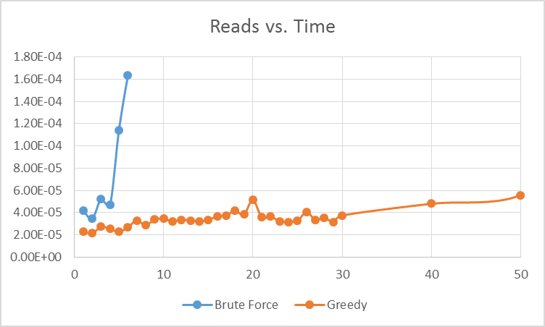
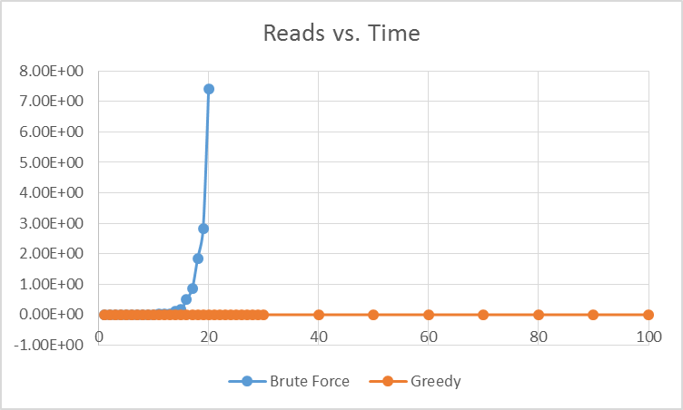
Performance
For 20 SNPs, 5% chance of heterozygous, read length of 100 (3 trials each)

Slide 20
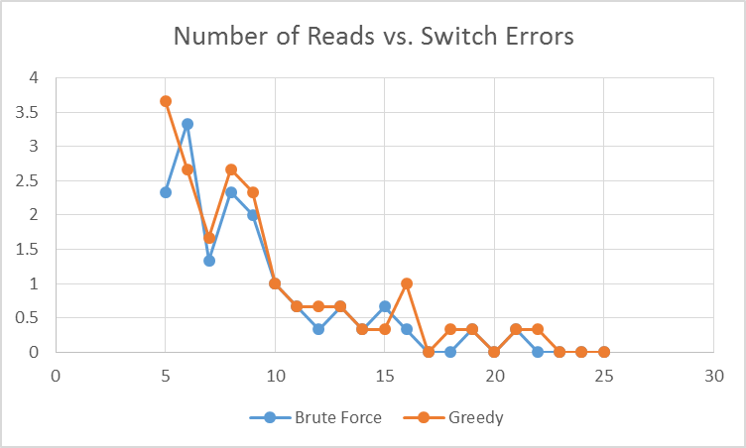
Error Performance
For 20 SNPs, 5% chance of heterozygous, read length of 100 (3 trials each)

Slide 21
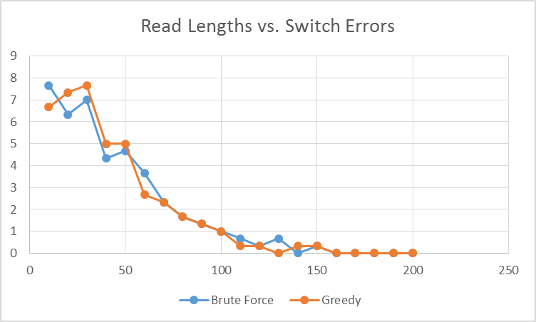
Error Performance
For 20 SNPs, 5% chance of heterozygous, 15 reads (3 trials each)

Slide 22
Results and Observations
Both solutions have the same problems with errors (SNPs with no overlaps)
However, the greedy solution speed scales much better as the number of reads increases
O(n) vs O(n*2^m)
Our greedy solution takes < 1 second up to approximately 750,000 reads
Accuracy depends on number of reads, read length (and heterozygous chance)
If the distance between SNPs is small enough (high chance of any SNP being heterozygous), there will be no errors since all heterozygous SNPs will likely have some overlap
If any distance between two SNPs is larger than our read length, we will not have overlap at the SNP. Then, we have a 50% chance of guessing the incorrect haplotype, causing a switch error

Slide 23
Questions

